Slide 1
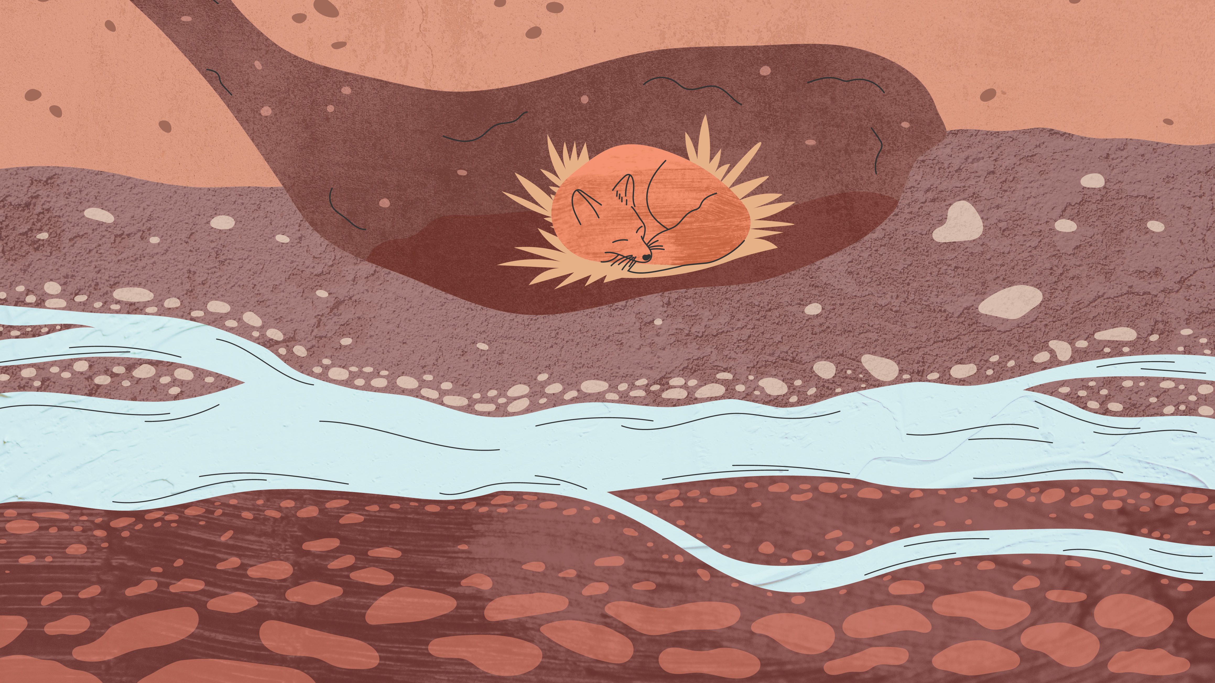

Conservation
gbif.org/conservation

Slide 2
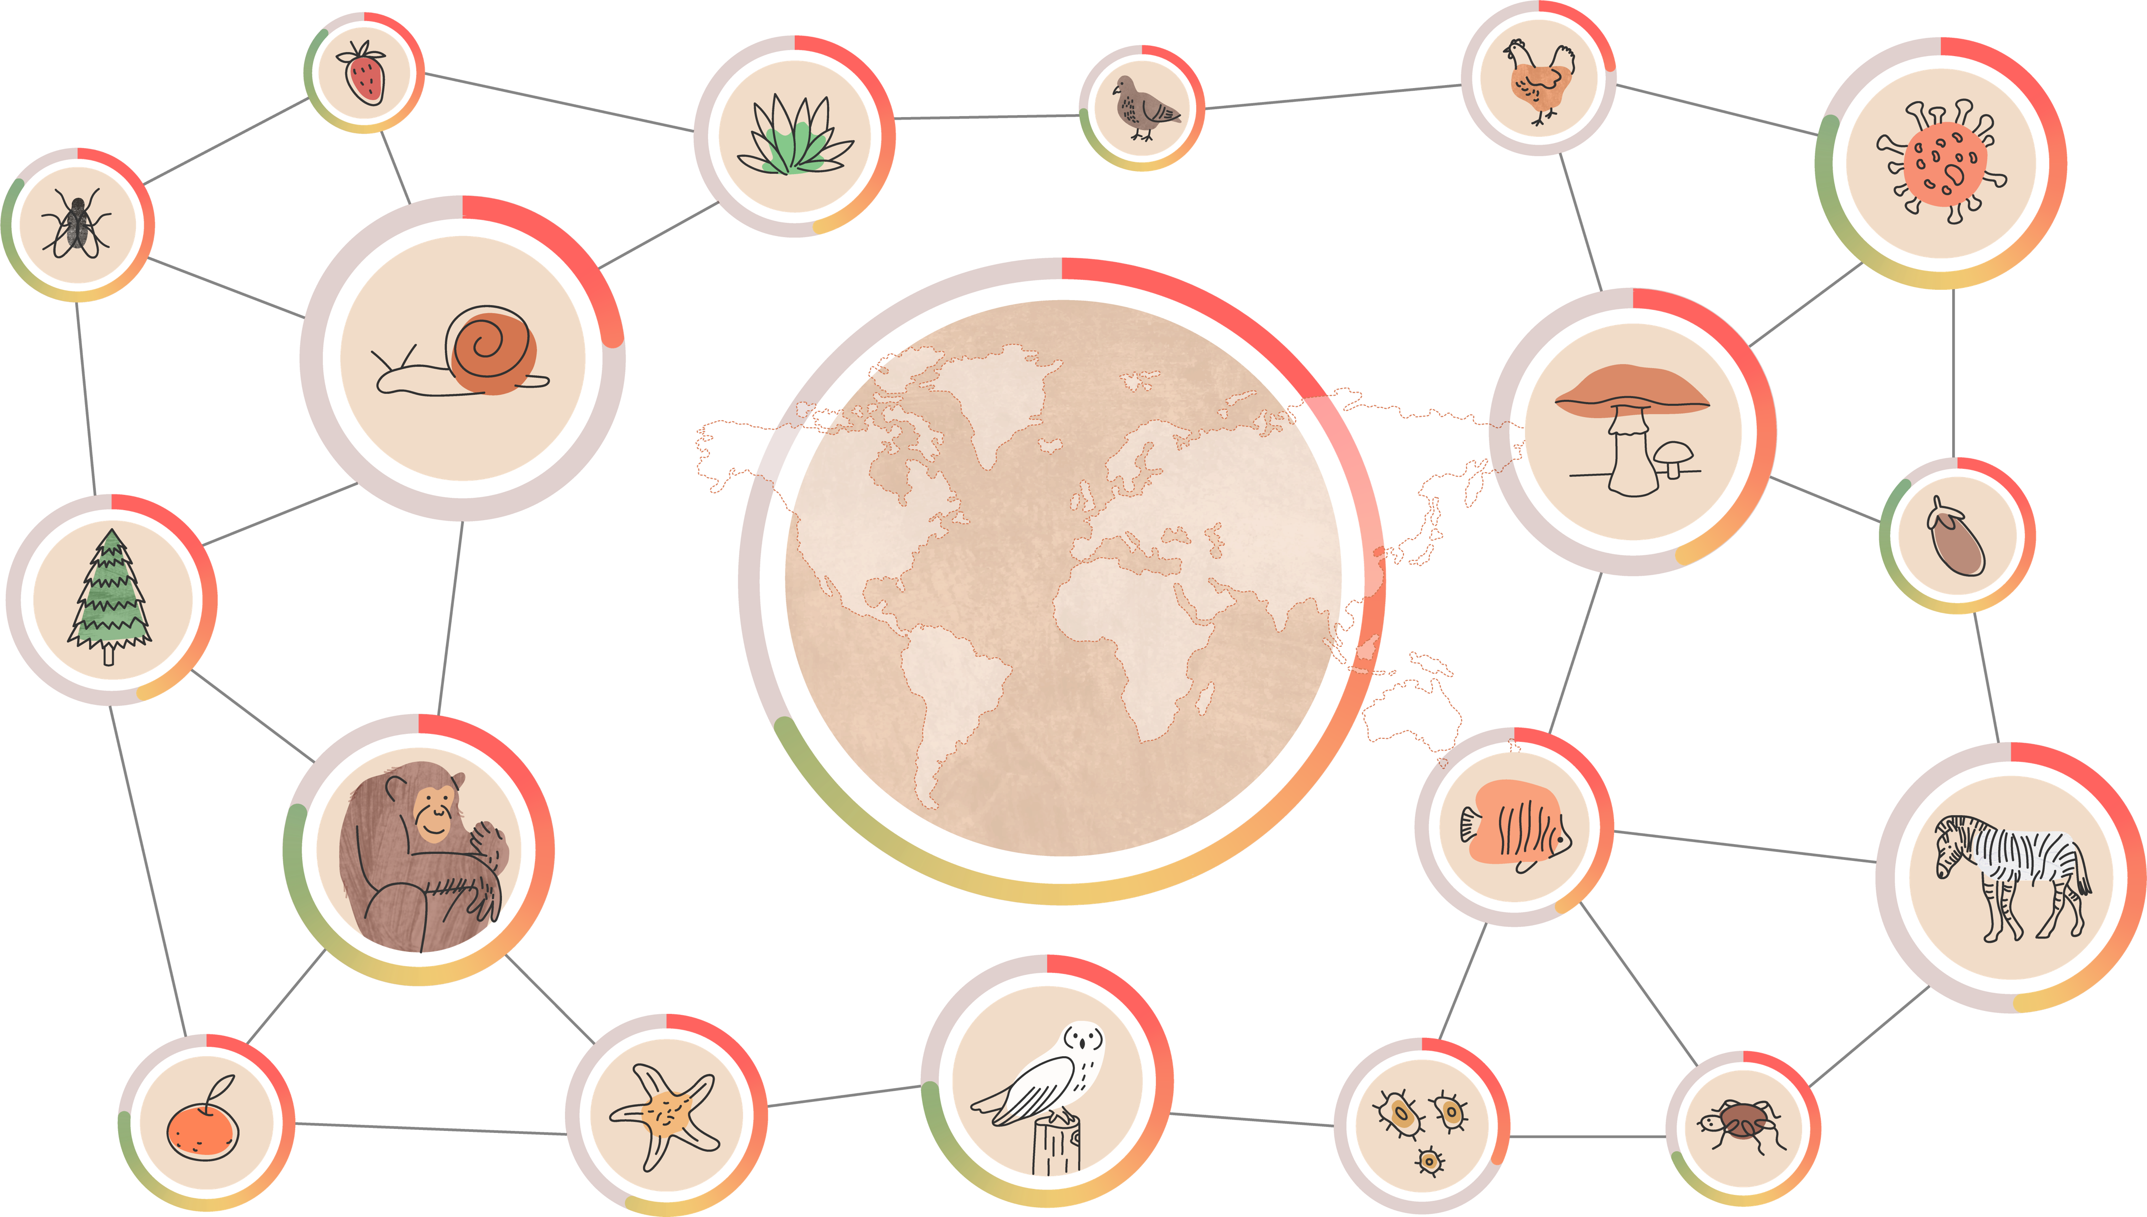
Conservation
Notes:
Text from postcard:
To track the state of the world's biodiversity, conservation practitioners rely on FAIR and open data from the GBIF network to assess species extinction risk, identify and conserve key biodiversity areas, and monitor invasive species.

Slide 3
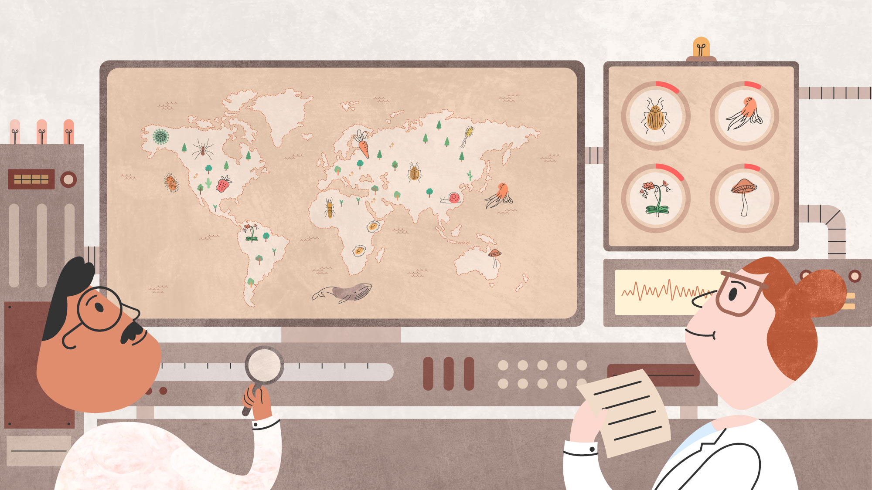
Conservation
GBIF provides essential information on the past and present occurrence of species for assessing extinction risk, identifying and conserving key biodiversity areas, and monitoring invasive species
Notes:
Notes

Slide 4
Conservation
Experts use open biodiversity data from the GBIF network to assess extinction risks, identify and conserve key biodiversity areas, and monitor invasive species.
Hundreds of conservation biology publications and thousands of extinction risk assessments have used data from the GBIF network to map and analyze species distributions and set conservation priorities. This wide-ranging research informs conservation practices and policies and provides a foundational layer for numerous indicators that measure the state of the world's biodiversity.

Slide 5
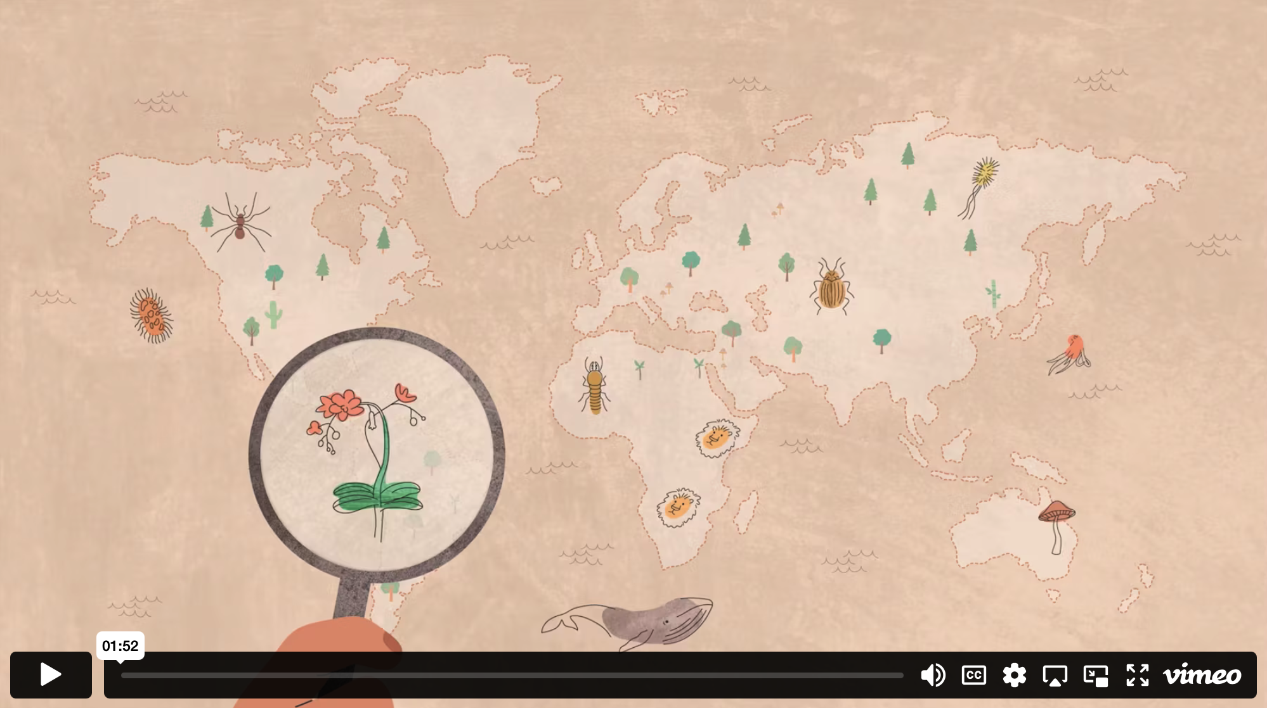
GBIF & conservation - Video

Slide 6
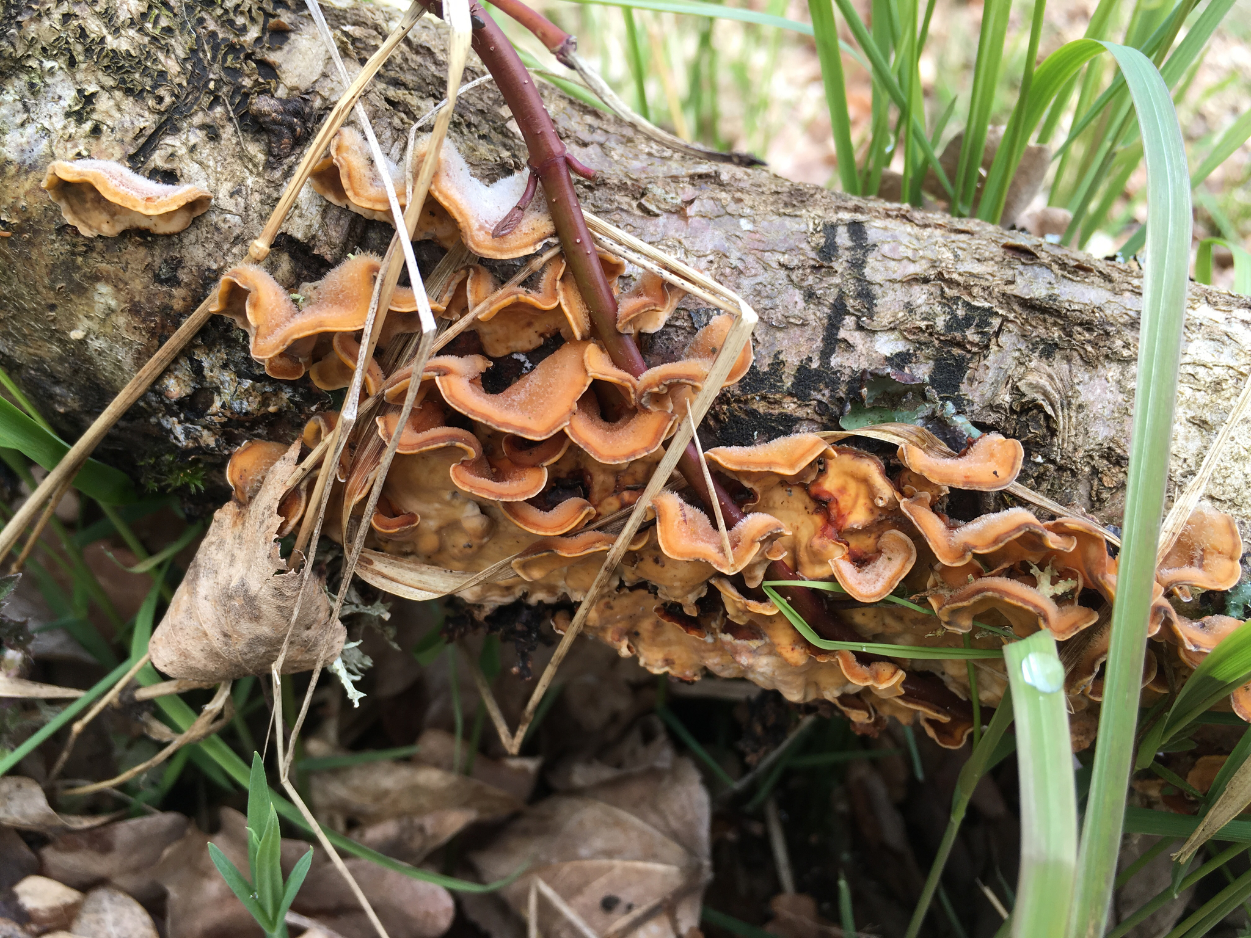
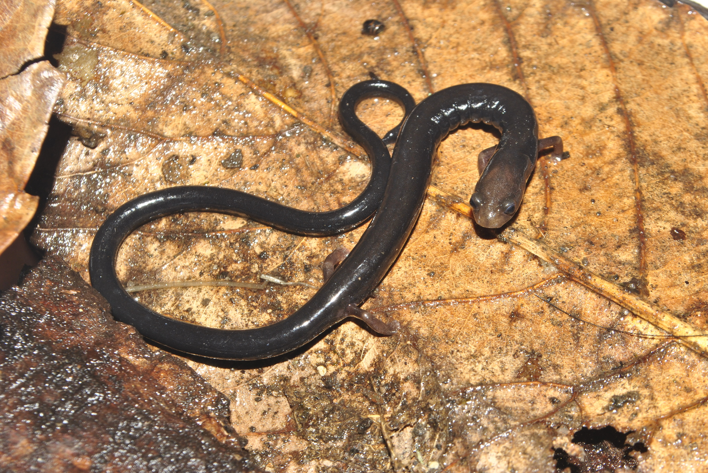
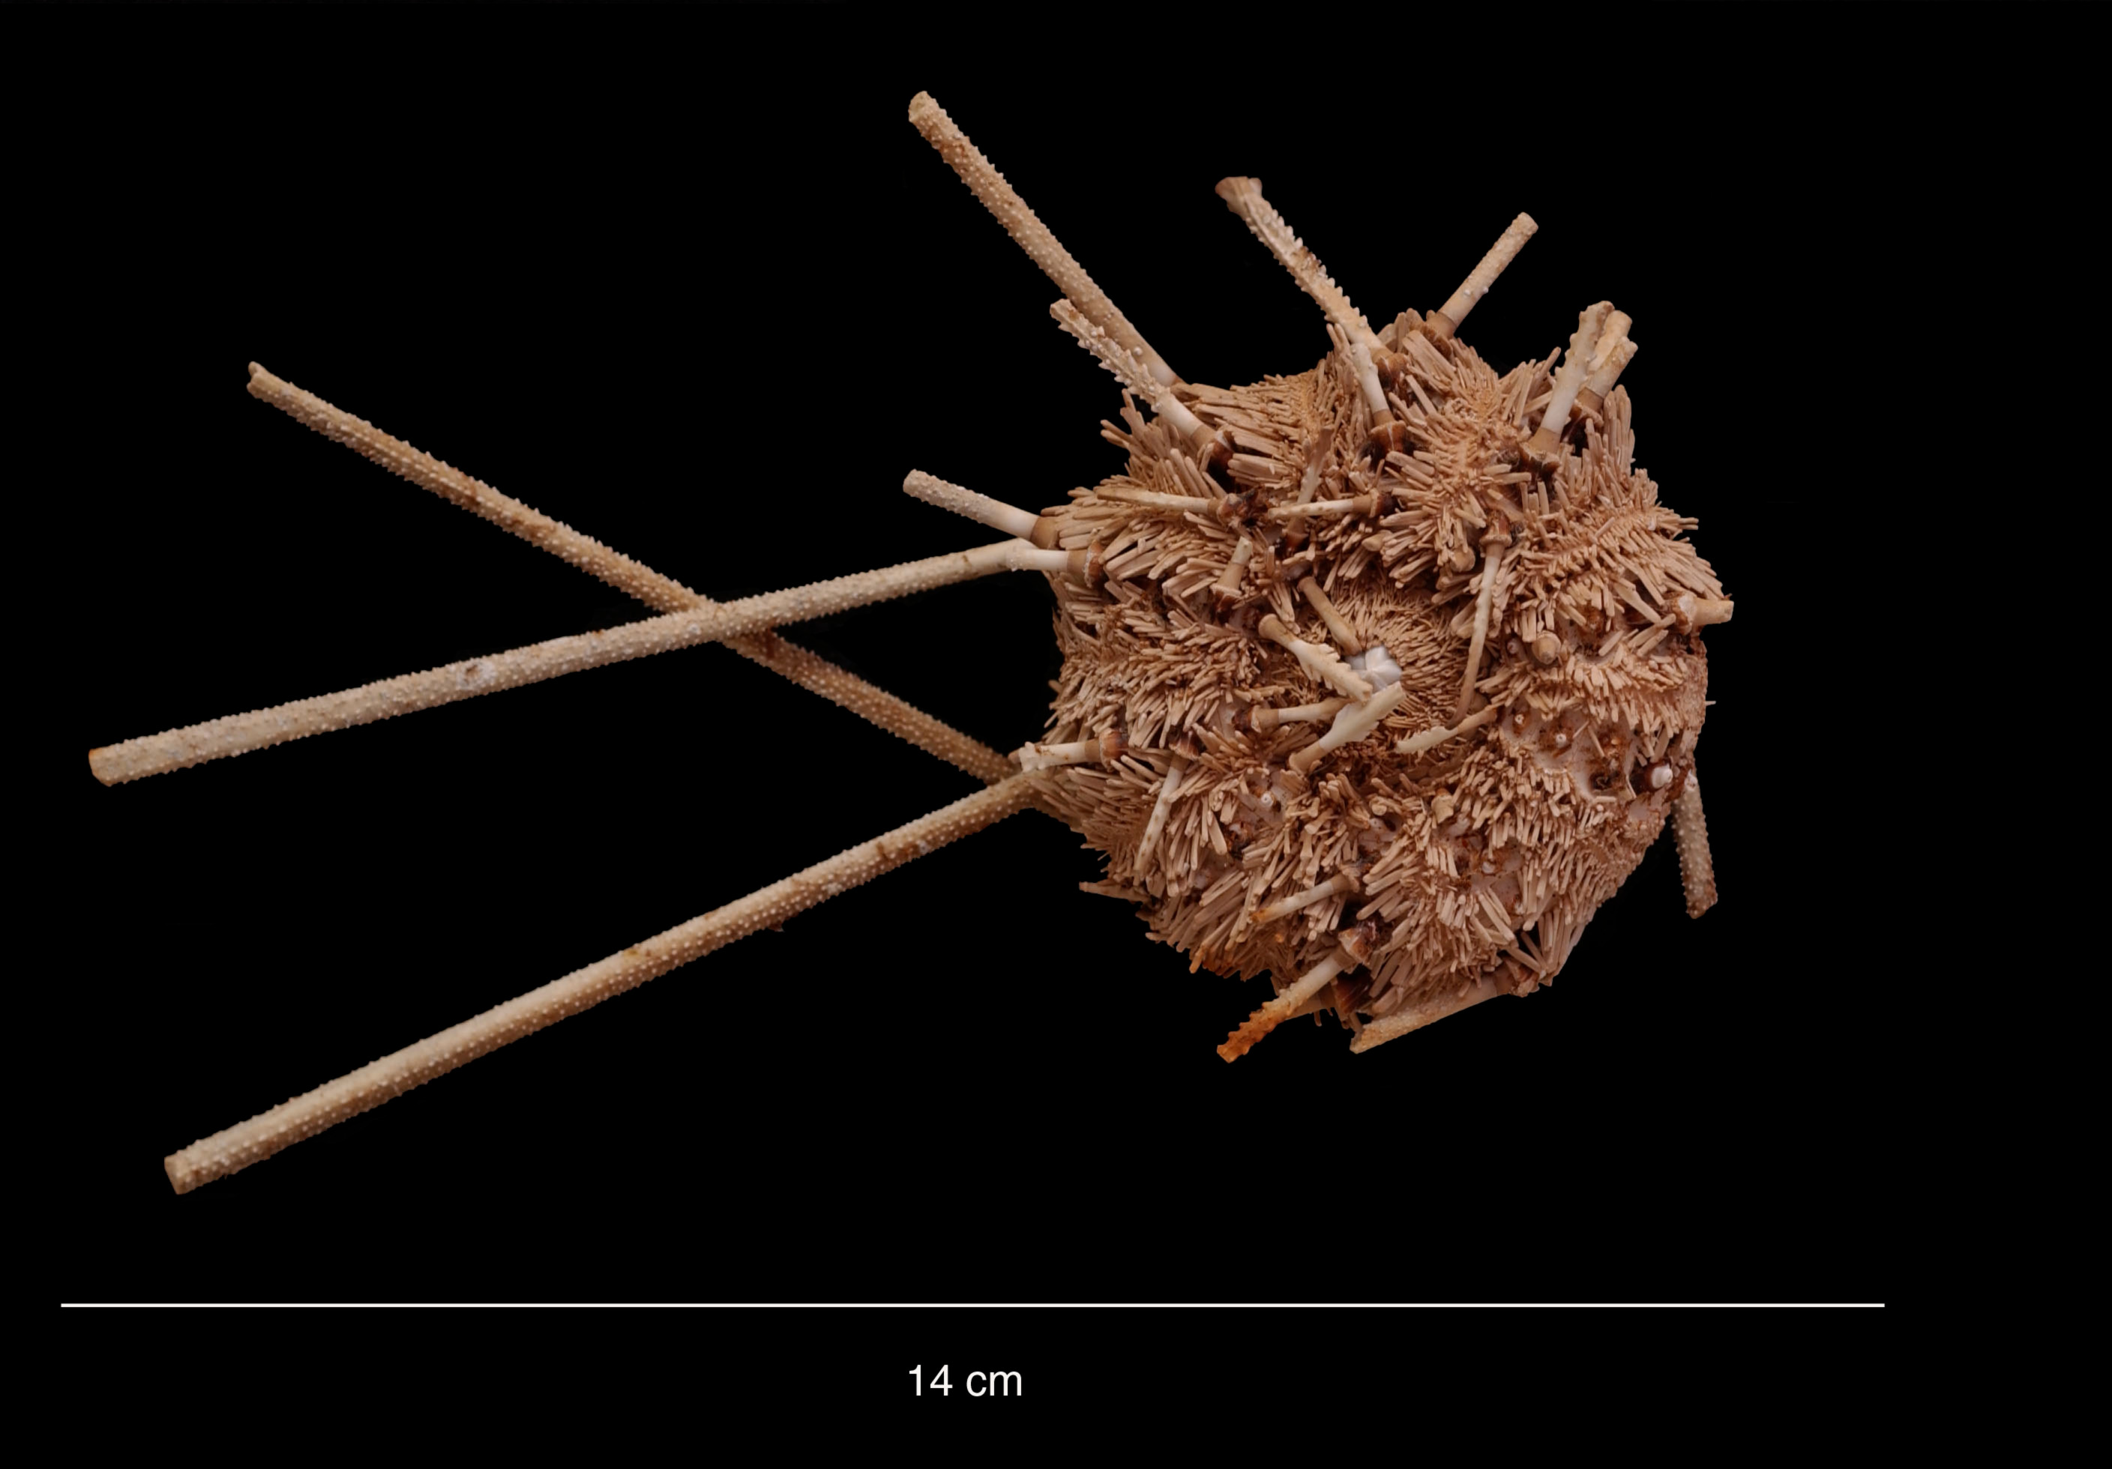
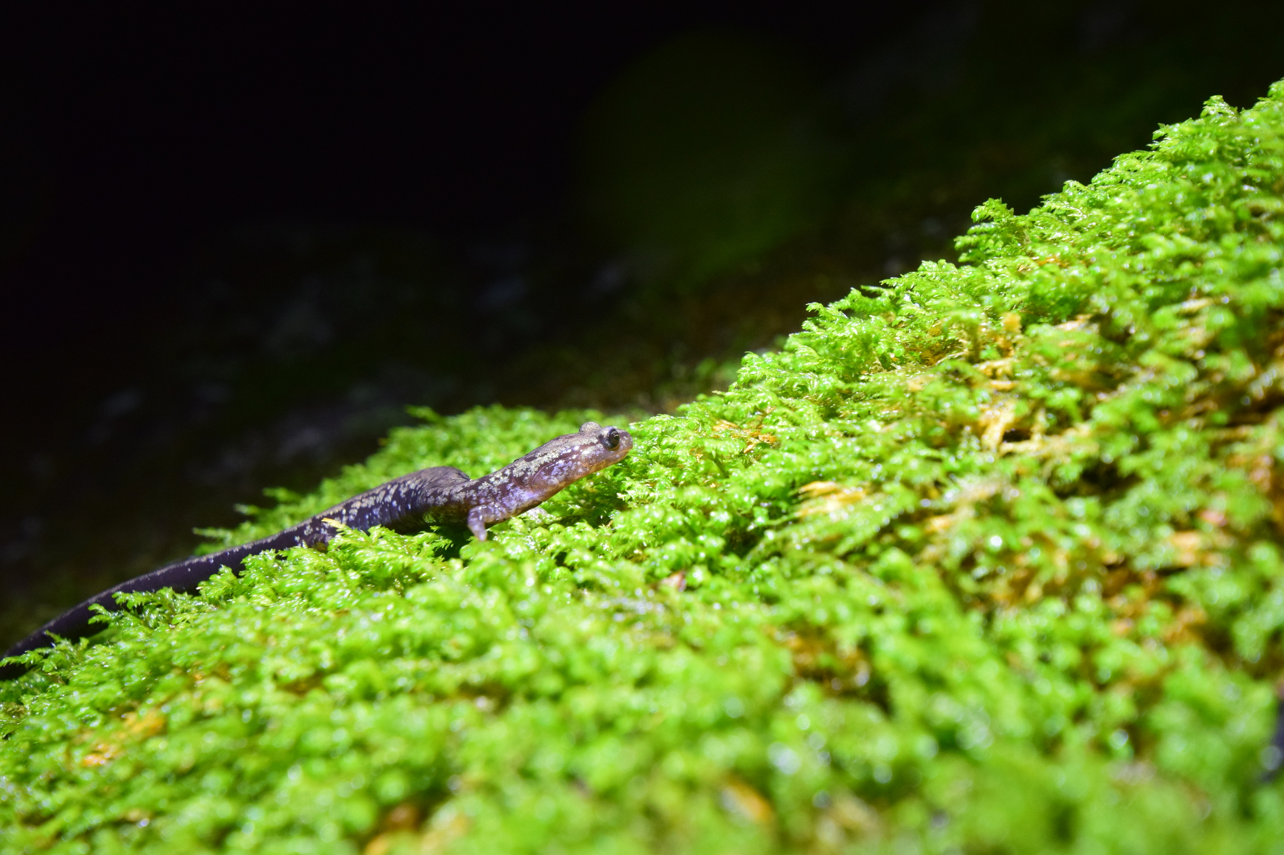
Recent data uses in conservation
Distribution and diversity of macrofungi in Europe
More than half the species in the IUCN Red List's Data Deficient category face risk of extinction
Measuring the effectiveness of protecting Southern Ocean sea floors with Antarctic sea urchins
Current and future coverage of protected areas in the Appalachian Mountains
Notes:
Notes

Slide 7
Conservation
Learn more!

